Slide 1

Statistical modelling

Slide 2
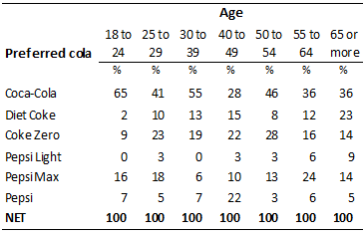

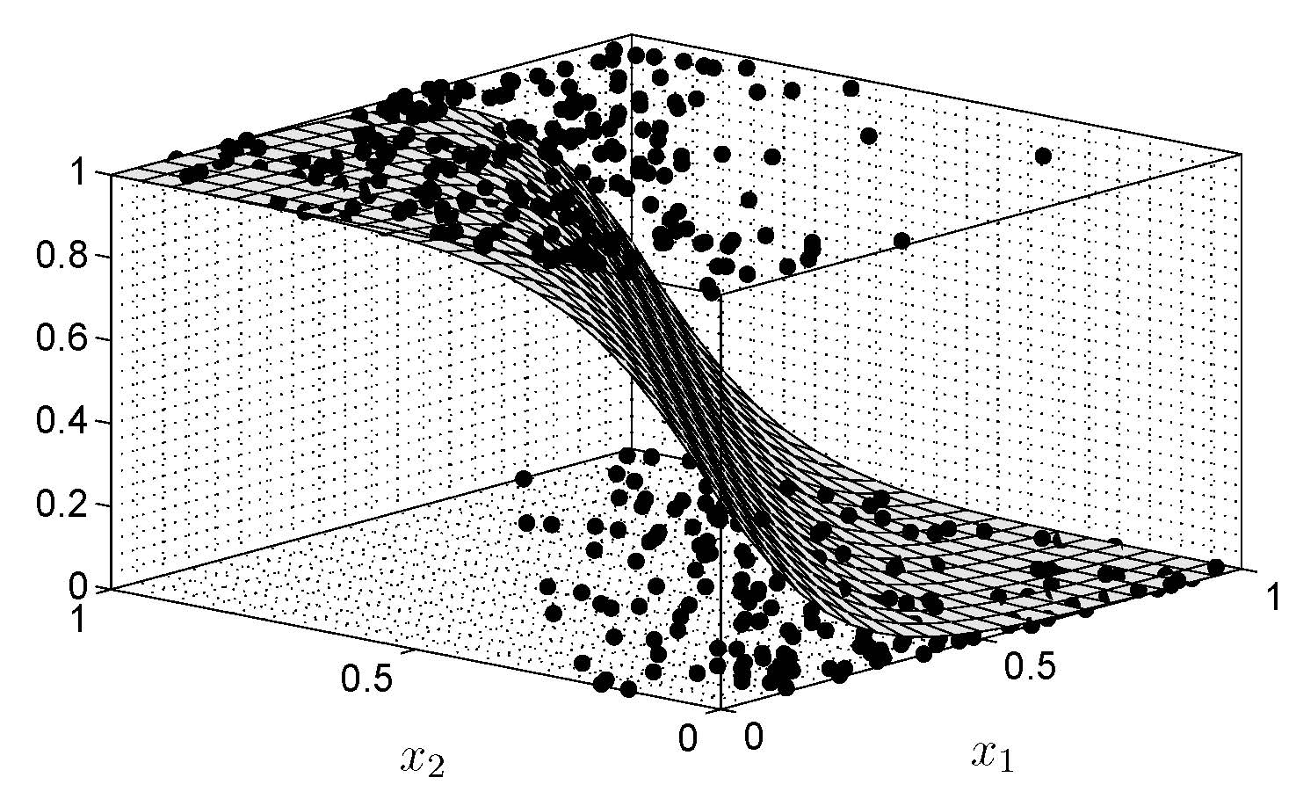
Statistical modelling
Statistics
Modelling
+
Statistical model
=

Slide 3

Defination
Statistical modelling is a simplified, mathematically-formalized way to approximate reality (i.e. what generates your data) and optionally to make predictions from this approximation.
In simple terms it is a method or technique to summarize huge data and to make valid & required predictions out of it.

Slide 4
Types of models
Linear Regression
Logistic Regression
Polynomial Regression
Stepwise Regression
Ridge Regression
Lasso Regression
Elastic Net Regression

Slide 5
steps in statistical modelling
Select a candidate model
Estimate its unknown quantities (the parameters; fit the model to data)
Compare the fitted model to alternative models

Slide 6
Use of Statistical Modelling
Identifying patterns in data
Classifying events
Untangling multiple influences
Assessing strength of evidence

Slide 7
Deep into models

Slide 8
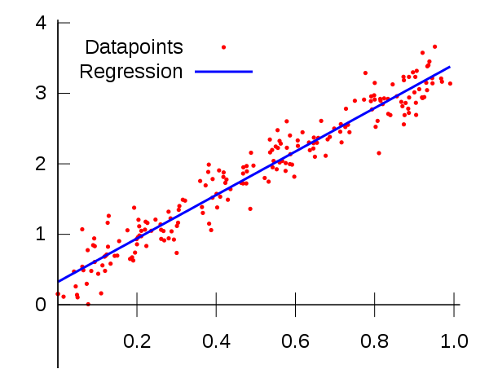
Linear Regression
It establishes a relationship between dependent variable (Y) and one or more independent variables (X) using a best fit straight line (also known as regression line).
E.g: Y=a+b*X + e

Slide 9
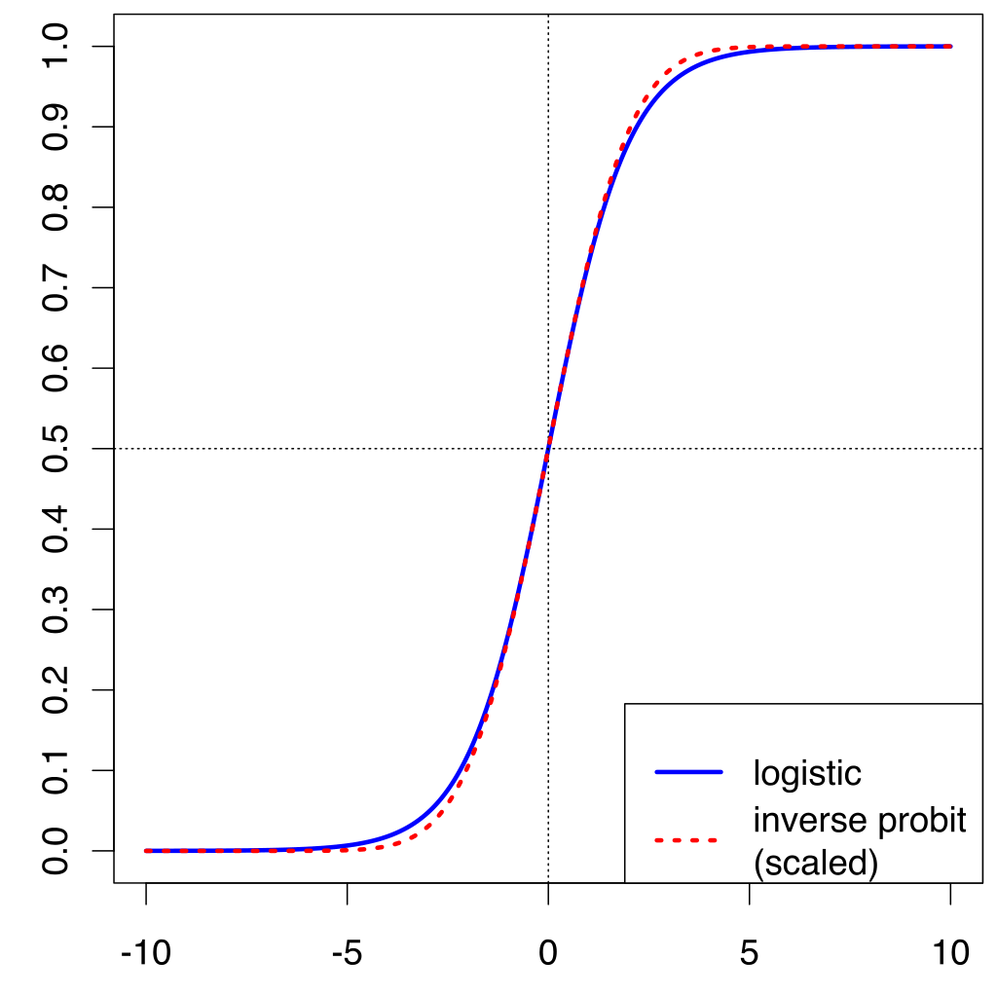
Logistic Regression
It is used to find the probability of event to be Success or Failure.

Slide 10
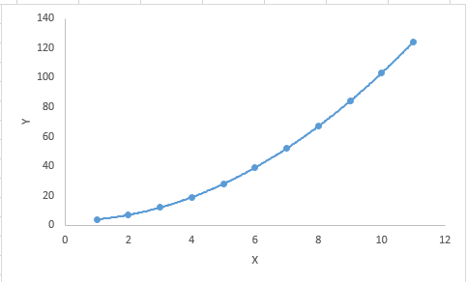
Polynomial Regression
A regression equation is a polynomial regression equation if the power of independent variable is more than 1.

Slide 11
Need of sm in machine learning
Statistical modelling focuses on understanding data.
Whereas machine learning aims to predict future.
In order to predict future we need structured data.
Hence Statistical Modelling is used to structure and model the data to make prediction part easy.

Slide 12
conclusion
Statistical Modelling
a subfield of mathematics which deals with finding relationship between variables to predict an outcome
Machine Learning:
a subfield of computer science and artificial intelligence which deals with building system subfield of computer science and artificial intelligence which deals with building systems that can learn from data, instead of explicitly programmed instructions.

